Slide 1
Node JS - Events
S.Karthiga,
Assistant Professor,
Department of IT, TCE

Slide 2
Session Outcomes
At the end of this session, students will be able to,
Apply node js – event module for the given problem

Slide 3
Events Module
Node.js has a built-in module, called "Events", where you can create-, fire-, and listen for- your own events.
To include the built-in Events module use the require() method.
All event properties and methods are an instance of an EventEmitter object.

Slide 4
Event Emitter Object
To be able to access these properties and methods, create an EventEmitter object.
Can assign event handlers for the events created
All objects that emit events are instances of the EventEmitter class.
The event can be emitted or listen to an event with the help of EventEmitter.
Syntax : -
var events = require('events'); var eventEmitter = new events.EventEmitter();

Slide 5
Listening events
Before emits any event, it must register functions(callbacks) to listen to the events
eventEmitter.addListener(event, listener)
eventEmitter.on(event, listener)
eventEmitter.once(event, listener)
1 & 2 methods => Multiple calls to the same event and listener will add the listener multiple times and correspondingly fire multiple times.
3 method fires at most once for a particular event and will be removed from listeners array after it has listened once.

Slide 6
Emitting Events
Every event is named event in nodejs.
The event can be triggered by the function
emit(event, [arg1], [arg2], […])
We can pass an arbitrary set of arguments to the listener functions.

Slide 7
Example
// Importing events
const EventEmitter = require('events');
// Initializing event emitter instances
var eventEmitter = new EventEmitter();
// Registering to myEvent
eventEmitter.on('myEvent', (msg) => {
console.log(msg);
});
// Triggering myEvent
eventEmitter.emit('myEvent', "First event");

Slide 8
Event Handlers
Assign event handlers to your own events with the EventEmitter object.
Ex:-
var events = require('events');
var eventEmitter = new events.EventEmitter();
var myEventHandler = function () {
console.log(WELCOME!');
}
eventEmitter.on(‘msg', myEventHandler);
eventEmitter.emit(‘msg');

Slide 9
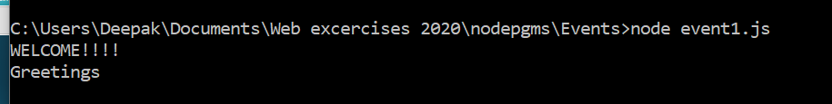
Other way
eventEmitter.on ('msg', () => {
console.log(‘Greetings');
});

Slide 10
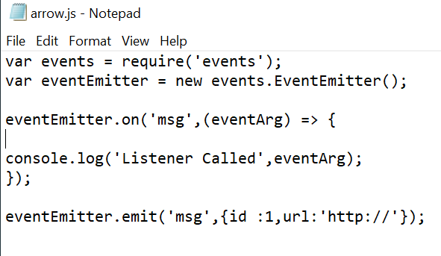
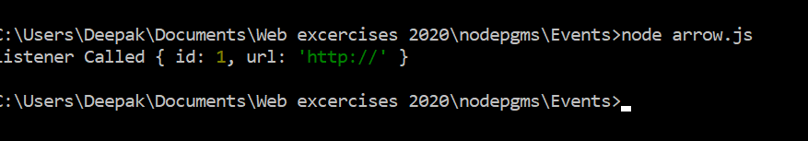
Event with args & arrow function

Slide 11
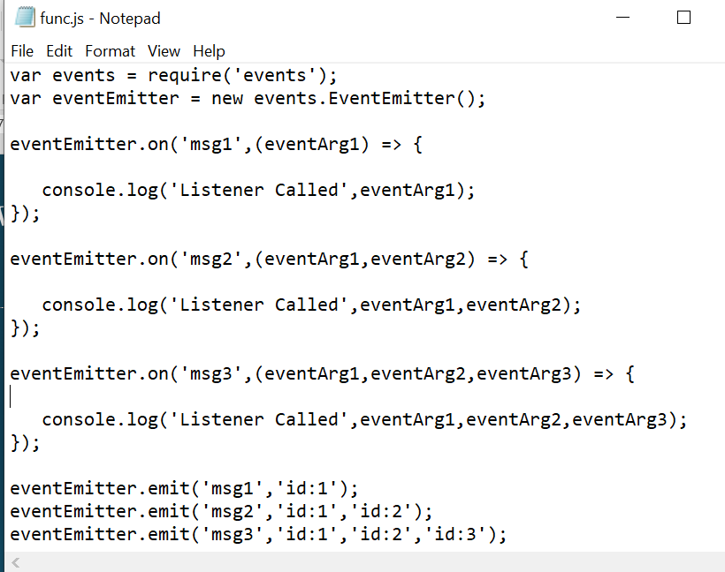
Event with Listeners function

Slide 12
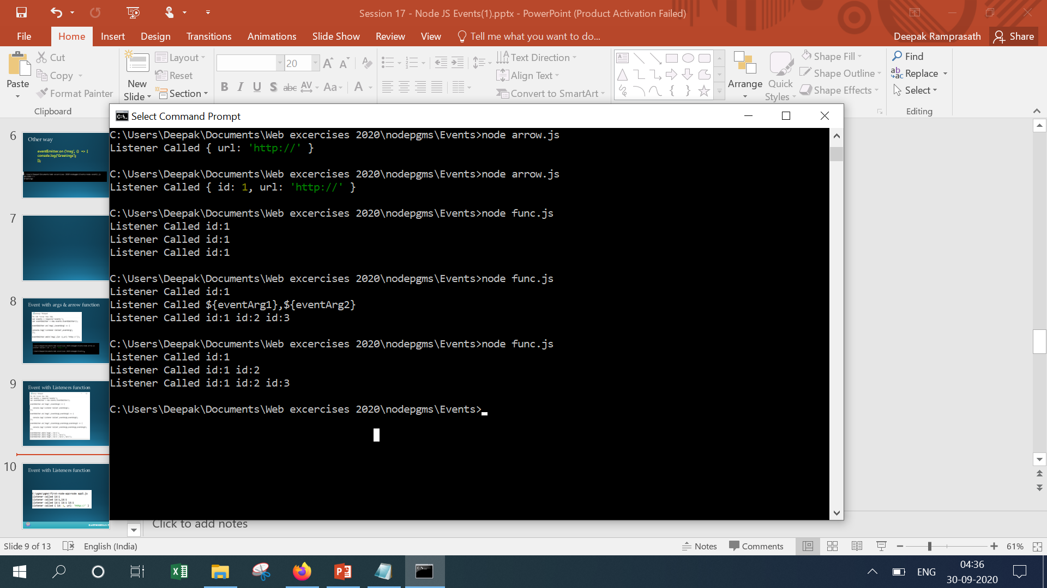
Event with Listeners function

Slide 13
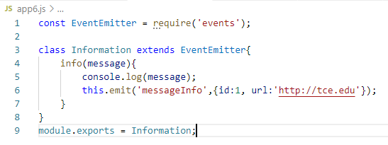
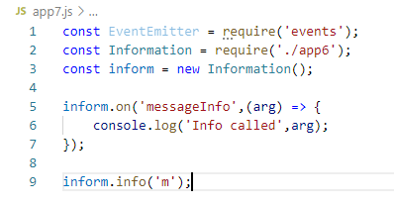

EventEmitter - Extending

Slide 14
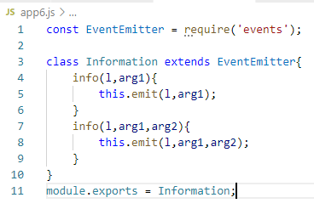
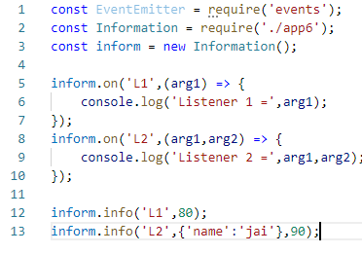
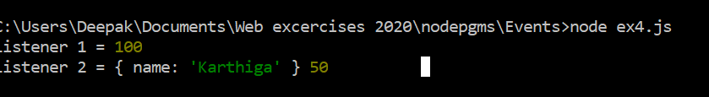
EventEmitter - Extending

Slide 15
Demo

